Slide 1
运用Java的类继承、抽象类、接口等机制设计和实现组类：
  定义一个抽象类Mails（包括两个表示邮件寄出和送往地址的变量和一个显示邮件自身信息的方法showMe()），然后派生出它的两个子类Parcel(包裹)和Remittance(汇款);
  类ShowMails用于存取邮件（包括类型为Mails的邮件列表[数组]变量showList[]、最大邮件个数变量和当前邮件个数变量，以及加入putMails()、获取getMails()、展示邮件的方法showAll()）
  接口MailPost定义两个邮寄方法的原型：callPrice()计算邮费并以浮点数形式返回、post()完成邮寄；
  在Parcel(包裹)和Remittance(汇款)的基础上分别派生出可邮寄的包裹和汇款：PostParcel和Postemit两个子类 ;

Slide 2
运用Java的类继承、抽象类、接口等机制设计和实现一个邮件类：
  类Show用于实际执行，完成对各类邮件的管理工作
    从程序外部接收输入的类型PostParcel或者Postemit，
    再根据类型创建相应的对象，对象的内容比如邮件寄出、送往地址、汇款金额、包裹重量等等信息也从外部输入
  BufferedReader reader=new BufferedReader(new InputStreamReader(System.in))
    将创建的对象通过ShowMails类来管理 (putMails)；
    最后通过ShowMails类的getMails方法输出所有的对象。

Slide 3
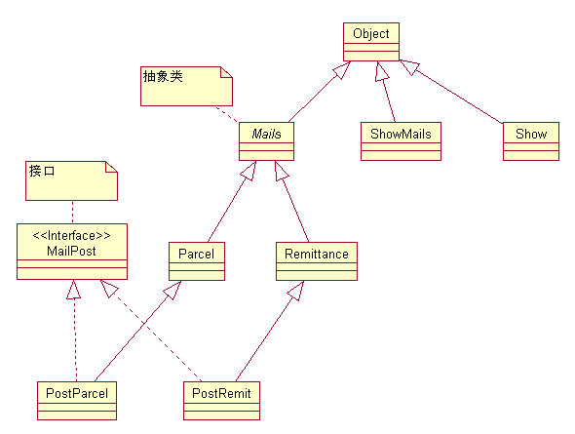

Slide 4
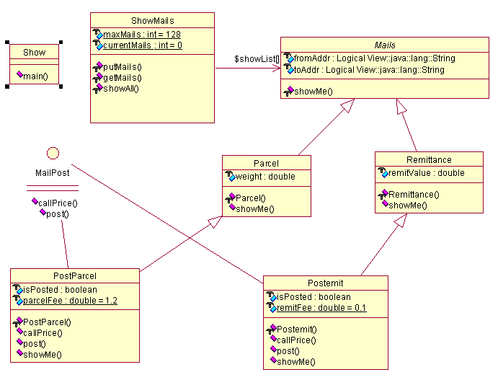

Slide 5
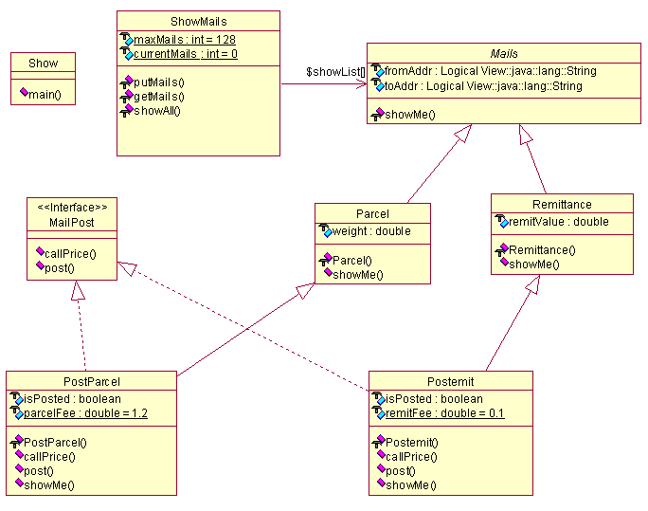

Slide 6
Mails
package mymails;
public abstract class Mails
{
String fromAddr;
String toAddr;
abstract void showMe();
}

Slide 7
Parcel
package mymails;
public class Parcel extends Mails
{
double weight;
Parcel(String from,String to,double weight){
fromAddr = from;
toAddr = to;
this.weight = weight;
}
public void showMe()
{
System.out.println("This is a Parcel from " + fromAddr + " to " + toAddr);
System.out.println("And its weight is " + weight);
}
}

Slide 8
Remittance
package mymails;
public class Remittance extends Mails
{
double remitValue;
Remittance(String from,String to,double remitValue)
{
fromAddr = from;
toAddr = to;
this.remitValue = remitValue;
}
public void showMe()
{
System.out.println("This is a Remittance " + remitValue + " from" + fromAddr + " to " + toAddr);
}
}

Slide 9
MailPost
package mymails;
public interface MailPost
{
double callPrice();
void post();
}

Slide 10
Postemit
package mymails;
public class Postemit extends Remittance implements MailPost
{
boolean isPosted;
static double remitFee = 0.1;
Postemit(String from,String to,double remitValue)
{
super(from,to,remitValue);
isPosted = false;
}
public double callPrice()
{
return remitFee * remitValue + 1.0;
}

Slide 11
Postemit
public void post(){
isPosted = true;
System.out.println("You have paid " + callPrice() + " for this Remittance...");
System.out.println("Your remittance has been posted.");
}
public void showMe(){
super.showMe();
System.out.println("This remittance's fee is " + callPrice());
if (isPosted){
System.out.println("This remittance has been posted...");
}
else
{
System.out.println("This remittance has not been posted...");
}
System.out.println();
}
}

Slide 12
PostParcel
package mymails;
public class PostParcel extends Parcel implements MailPost
{
boolean isPosted;
static double parcelFee = 1.2;
PostParcel(String from,String to,double weight)
{
super(from,to,weight);
isPosted = false;
}
public double callPrice(){
return parcelFee * weight + 1.0;
}

Slide 13
PostParcel
public void post(){
isPosted = true;
System.out.println("You have paid " + callPrice() + "
for this Parcel...");
System.out.println("Your parcel has been posted.");
}
public void showMe(){
super.showMe();
System.out.println("This Parcel's fee is " + callPrice());
if (isPosted){
System.out.println("This Parcel has been posted...");
}
else
{
System.out.println("This Parcel has not been posted...");
}
System.out.println();
}
}

Slide 14
ShowMails
package mymails;
public class ShowMails
{
static int maxMails = 128;
static int currentMails = 0;
static Mails[] showList = new Mails[maxMails];
static int putMails(Mails mail)
{
if (currentMails >= maxMails)
{
System.out.println("Mailbox overwhelmed!");
return -1;
}
showList[currentMails] = mail;
currentMails ++;
return currentMails;
}

Slide 15
ShowMails
static Mails getMails(){
if (currentMails == 0)
{
System.out.println("No mail in the mail box...");
return null;
}
currentMails --;
return showList[currentMails];
}
static void showAll(){
int i;
for (i=0; i<currentMails; i++)
{
showList[i].showMe();
}
return;
}
}

Slide 16
Show
package mymails;
import java.io.*;
public class Show
{
public static void main(String args[]){
String fromAddr;
String toAddr;
String mailType;
String endSignal;
Mails newmail;
double weight;
double remitValue;
boolean isParcel = false;
BufferedReader reader=new BufferedReader(new InputStreamReader(System.in));

Slide 17
Show
while(true)
{
while(true)
{
System.out.print("Please input the postmail type(postparcel- p;postremittance-r):");
try
{
mailType = reader.readLine(); if(mailType.equals("p")) { isParcel = true;
}
else if (mailType.equals("r")) {
isParcel = false;
}
else{
throw(new NumberFormatException());
}
System.out.println("Input mail messages:");
System.out.print("sourceAddress:");
fromAddr = reader.readLine();
System.out.print("destinationAddress:");
toAddr = reader.readLine();

Slide 18
Show
if(isParcel){
System.out.print("weight:");
weight = Double.parseDouble(reader.readLine());
newmail = new PostParcel(fromAddr,toAddr,weight);
}
else{
System.out.print("remitvalue:");
remitValue = Double.parseDouble(reader.readLine());
newmail=new Postemit(fromAddr,toAddr,remitValue);
}
break;
}
catch(NumberFormatException e) {
System.out.println("This value does not measure,reinput plz!");
}
catch(IOException e){}
}
ShowMails.putMails(newmail);
System.out.println("New mail operation complete...");
System.out.print("Exit----------press e,Continue----------other keys:");

Slide 19
Show
try{
endSignal = reader.readLine();
if (endSignal.equals("e"))
break;
}
catch (IOException e){}
}
ShowMails.showAll();
MailPost tempMail = null;
System.out.println();
System.out.println("Starting posting all mails...");
System.out.println();
while(true){
tempMail = (MailPost)ShowMails.getMails();
tempMail.post();
System.out.println();
if (ShowMails.currentMails == 0){
System.out.println("All mails have been shown...");
break;
}
}
}
}

